Slide 1
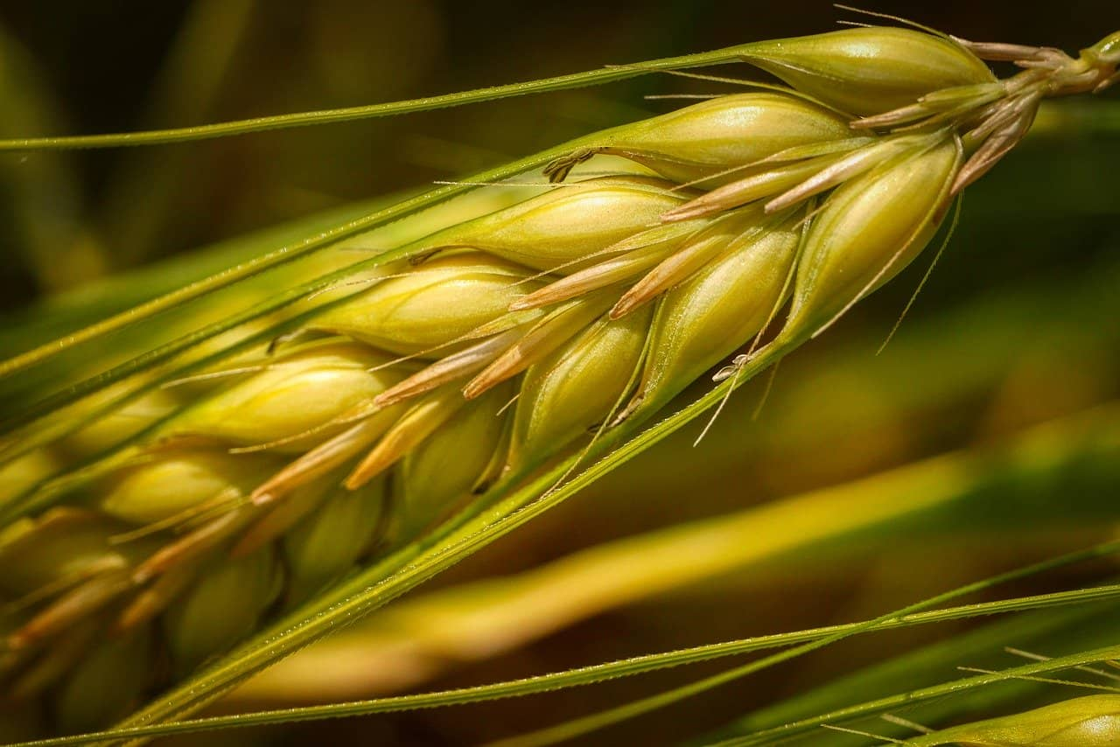
GLOBAL WHEAT DETECTION
INFO7390 Advances Data Sci/Architecture SEC 03
By
Group 14
Venkata Nitin Reddy Byreddy
Subbiah Cheranthian
Krithika Madabhooshi
Kavya Mannem

Slide 2
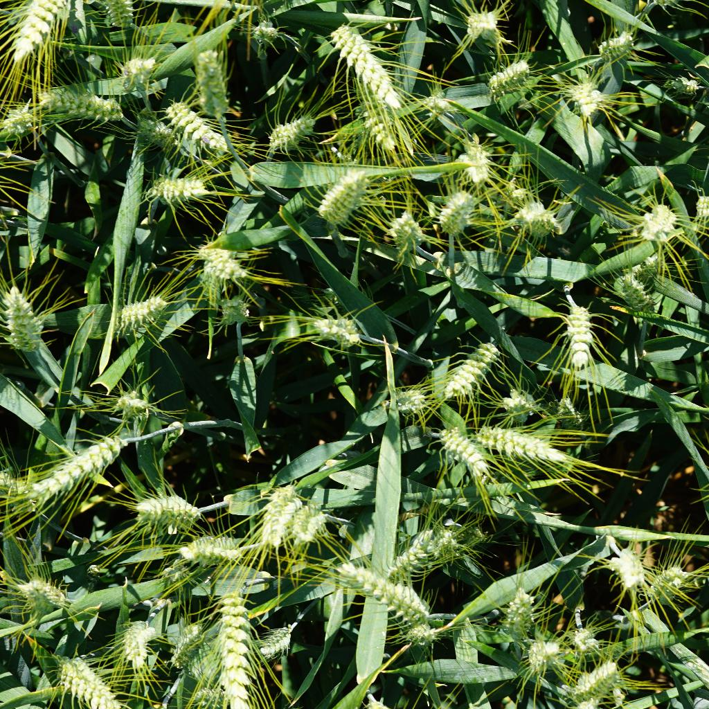
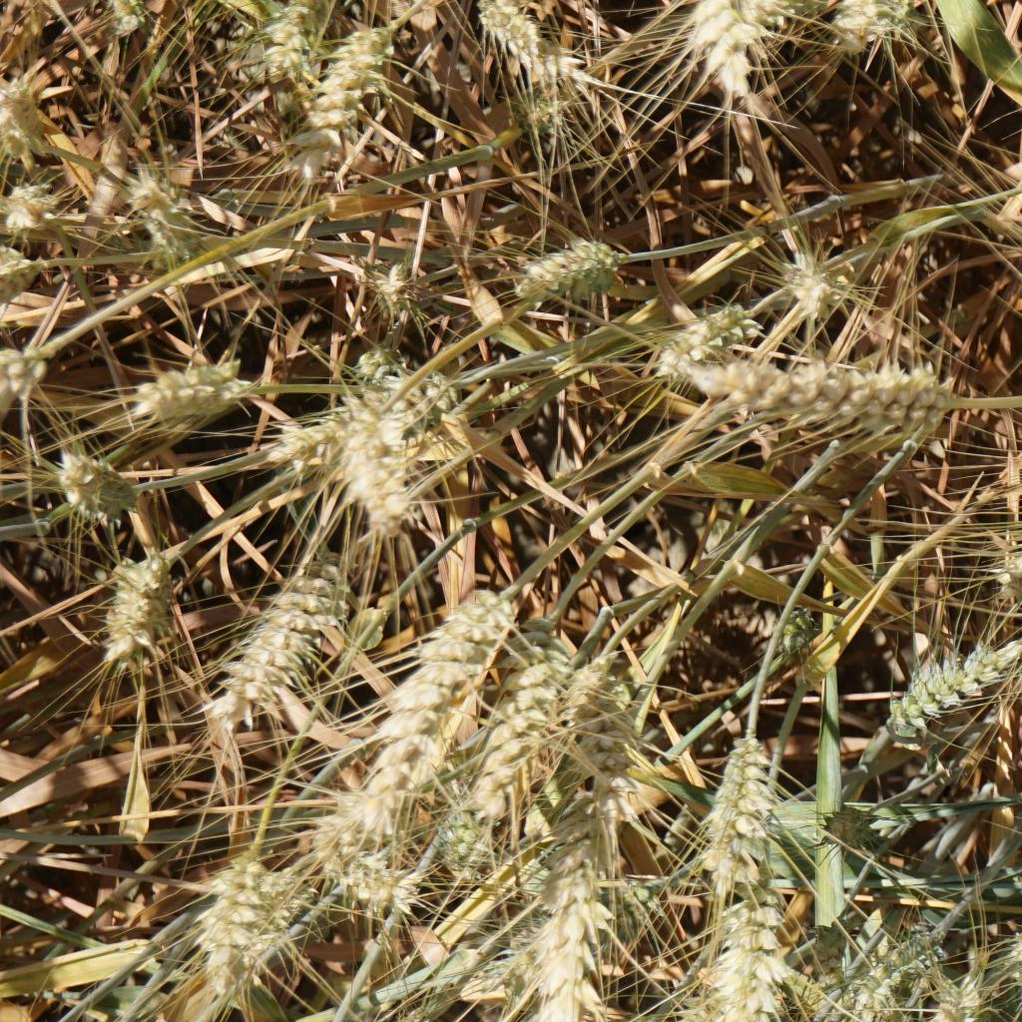
PROBLEM DESCRIPTION
Wheat is considered as one of the most strategic crop grown around the world. Its popularity as a food and crop makes wheat widely studied. However, accurate wheat head detection in outdoor field images can be visually challenging. There is often overlap of dense wheat plants, and the wind can blur the photographs. Both make it difficult to identify single heads.
DATASET
The Global Wheat Head Dataset is led by University of Saskatchewan and 8 other research institutes
It contains more than 4000 annotated images of wheat
The images in the dataset have many challenges like:
1. Different lighting
2. Contains few irrelevant objects
3. Has different species and maturity states

Slide 3
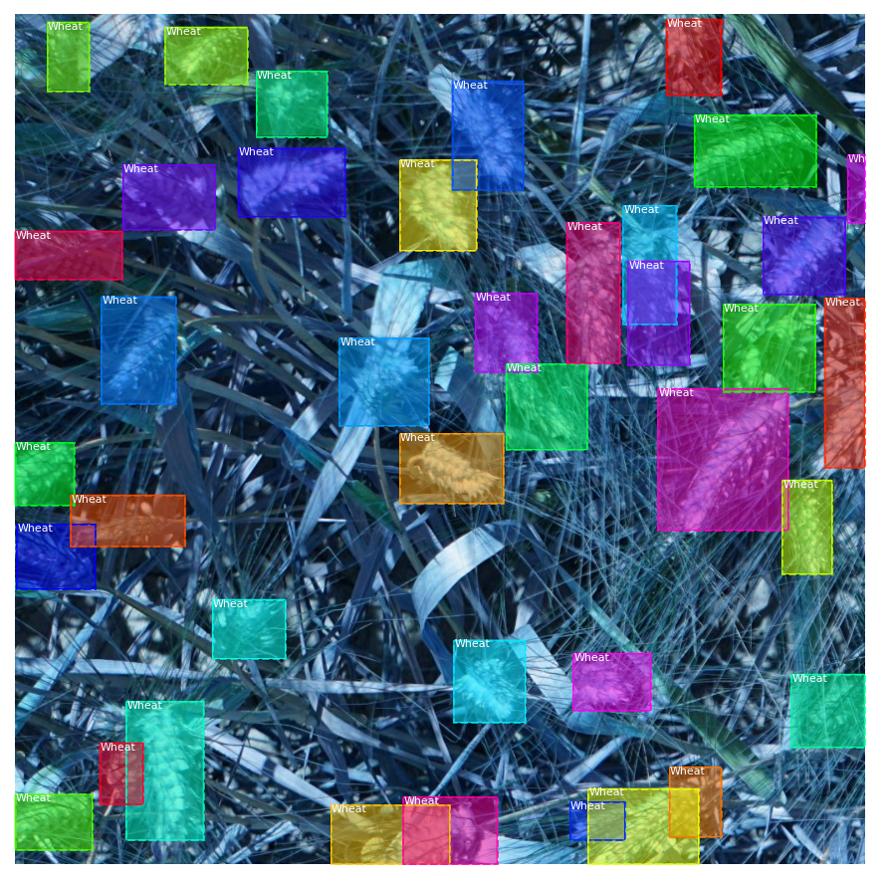
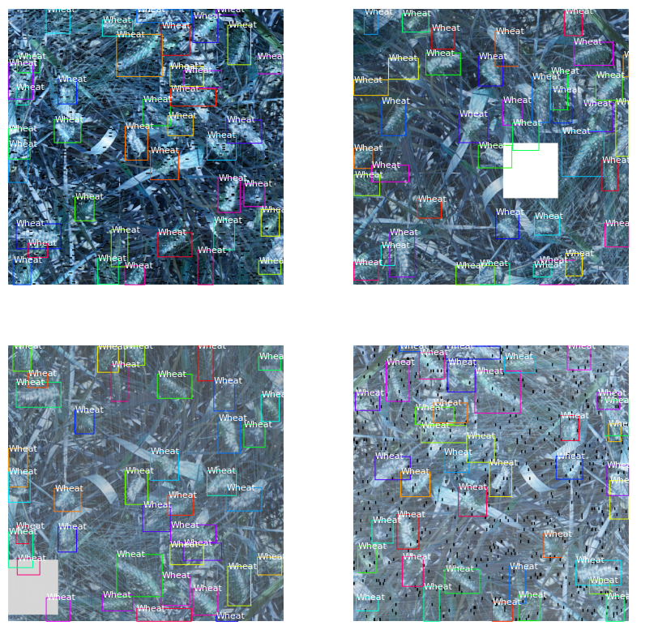
BOUNDING BOXES WITH SAMPLES
Imaginary box around objects
Coordinates of borders
If an image is not square, then zero padding is added at the top/bottom or right/left
IMAGE AUGMENTATIONS
Balance training data
Increasing the size & variety of training set without acquiring new images
Resizing all images

Slide 4
IMPLEMENTATIONS
Mask- RCNN
Simple to train
Outperforms all existing, single-model entries on every task
The method is very efficient and adds only a small overhead to Faster R-CNN
YOLO V3
All objects are classified by the same neural network
Has multi scale approach (3 scales)
Adapts anchor boxes from Faster R-CNN
FASTER R-CNN
Single-stage model that is trained end-to-end
Low computational time
Uses a novel region proposal network (RPN) for generating region proposals

Slide 5
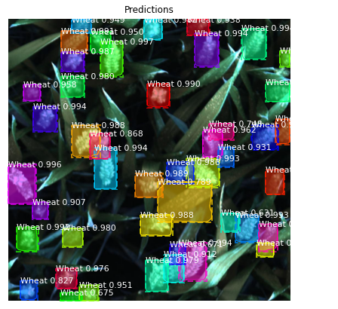
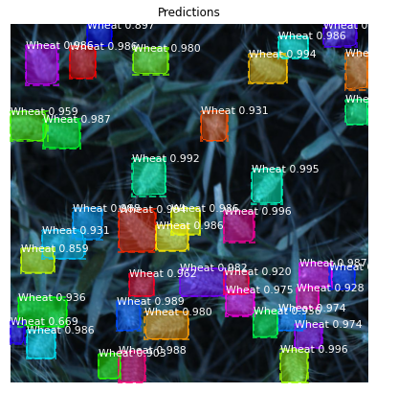
EVALUATION

Slide 6
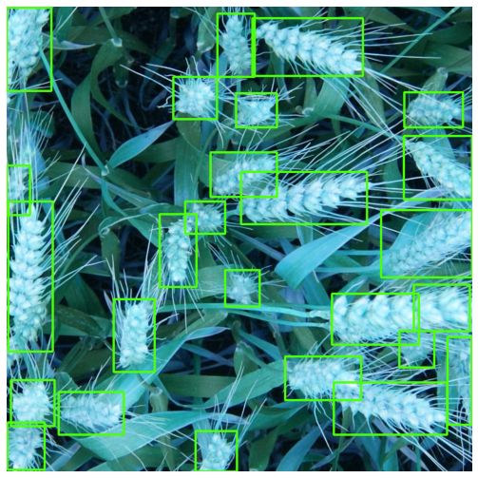
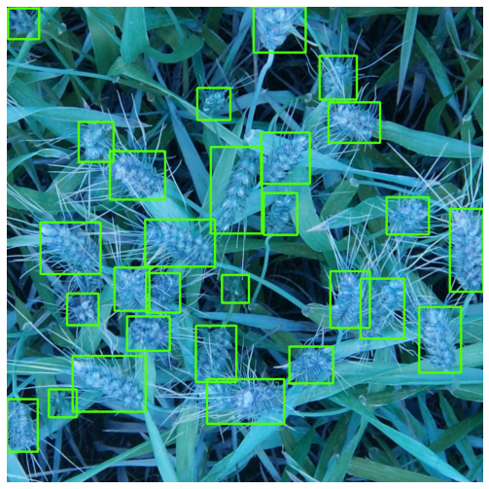
VISUAL PREDICTION

Slide 7
CONCLUSION
We have put together the Global Wheat Head Detection dataset, a large and varied dataset of wheat head photos, to enhance the precision and dependability of wheat head detection and localization. As a result of its ease in training, Masked RCNN was shown to be the best model for detecting the wheat head. When compared to Faster RCNN and YOLOv3, Masked RCNN has a lower overhead and has pixel-to-pixel alignment.
REFERENCES
https://viso.ai/deep-learning/mask-r-cnn/
https://github.com/DhruvMakwana/Global-Wheat-Detection/blob/master/Global_Wheat_Detection_EDA.ipynb
https://www.youtube.com/watch?v=cpSa0WMAkzY&list=LL&index=1&t=1444s
https://jonathan-hui.medium.com/image-segmentation-with-mask-r-cnn-ebe6d793272
https://alittlepain833.medium.com/simple-understanding-of-mask-rcnn-134b5b330e95
https://medium.com/@selfouly/part-2-fast-r-cnn-object-detection-7303e1988464
https://medium.com/mlearning-ai/object-detection-explained-faster-r-cnn-23e7ab57991d
https://docs.ultralytics.com/
https://medium.com/axinc-ai/yolov5-the-latest-model-for-object-detection-b13320ec516b
https://www.youtube.com/watch?v=80Q3HIBy7Qg&t=438s

